Slide 1
SOFTWARE METRICS

Slide 2
Human errors, faults, and failures
?
can lead to
can lead to
human error
fault
failure
Human Error: Designer’s mistake
Fault: Encoding of an error into a software document/product
Failure: Deviation of the software system from specified or expected behaviour
Notes:
A fault occurs when a human error results in a mistake in some software product. That is, the fault is the encoding of the human error. For example, a developer might misunderstand a user interface requirement, and therefore create a design that includes the misunderstanding. The design fault can also result in incorrect code, as well as incorrect instructions in the user manual. Thus, a single error can result in one or more faults, and a fault can reside in any of the products of development.
On the other hand, a failure is the departure of a system from its required behaviour. Failures can be discovered both before and after system delivery, as they can occur in testing as well as in operation. It is important to note that we are comparing actual system behaviour with required behaviour, rather than with specified behaviour, because faults in the requirements documents can result in failures, too.
In some sense, you can think of faults and failures as inside and outside views of the system. Faults represent problems that the developer sees, while failures are problems that the user sees. Not every fault corresponds to a failure, since the conditions under which a fault results in system failure may never be met.
Actual example:
Human error: Failure to distinguish signed and absolute value numbers in an algorithm
resulted in:
Fault: ‘X:=Y’ is coded instead of ‘X:= ABS(Y)’
which in turn led to
Failure: Nuclear reactor shut down because it was determined wrongly that a meltdown was likely.

Slide 3
Processing errors
In the absence of fault tolerance:
Human
Error
Fault
Processing
Error
Failure
Input
Notes:
We now need to introduce a further stage to this failure process that of the processing error. In general, the triggering of a fault may not lead to instantaneous failure; rather, an erroneous state arises within the system which at some later time leads to failure. Whether the failure happens will depend on the sequence of inputs processed by the system - a fault may reside in a program segment that is never executed thus preventing the processing error from occurring.
We can think of processing errors as intermediate states which when propagated through the system ultimately lead to failure. A basic example would be where an operating system fault is triggered by a particular input resulting in a processing error that causes a another processing error in the word-processor which then crashes.
If this erroneous state can be detected and countered before it is triggered by the input, it is possible to avoid the failure. It is this possibility which has led to the growth of the field of software fault tolerance - the search for methods which enable software to operate dependably even when it contains faults which have been triggered.

Slide 4
Relationship between faults and failures (Adams 1984)
Faults
Failures (sized by MTTF)
35% of all faults only lead to very rare failures (MTTF>5000 years)
Notes:
In real systems most faults are ‘benign’ in the sense that they lead only to very rare failures. Conversely a small proportion of faults account for most common failures.
Below MTTF = Mean Time To Failure
Adams looked at the failure data for these products. If a product was running on n installation each for y years when a particular failure is first observed at one of the installations then the Time to Failure is n × y years.
What the chart shows is that 35% of all failures are ‘very rare’ failures, i.e. those with MTTF of > 5000 years. In practical terms such failures are almost certainly only observed at one installation out of the many thousands which use the software. Conversely, a very small proportion of all failures (< 2%) are the ‘common’ failures, i.e. those with MTTF of < 50 years. The Adams’ data highlights the danger of associating a measure of fault density with software quality (especially if quality is synonymous with reliability which is defined as the probability of failure-free operation in a given time period under given operational conditions).
See [Adams 84] for more details

Slide 5
The relationship between faults and failures
Most faults are benign
For most faults: removal will not lead to greatly improved reliability
Large reliability improvements only come when we eliminate the small proportion of faults which lead to the more frequent failures
Does not mean we should stop looking for faults, but warns us to be careful about equating fault counts with reliability
Notes:
This does not mean that fault removal does not lead to improved reliability. It is possible (if we are unlucky enough with our test selection) to remove 98% of all faults in a system without achieving any real reliability improvement. In practice, without any prior knowledge about the faults we would hope that our testing does discover a reasonable proportion of the 2% of the important faults.

Slide 6
The ‘defect density’ measure: an important health warning
Defects = {faults} ∪ {failures}
but sometimes defects = {faults} or defects = {failures}
System defect density =
where size is usually measured as thousands of lines of code (KLOC)
Defect density is used as a de-facto measure of software quality.
in the light of the Adams’ data this is very dangerous
What are industry ‘norms’ and what do they mean?
number of defects found
system size
Notes:
The problem of defect density is accentuated by the problems with measuring size in terms of LOC as discussed earlier.
There is much inconsistency in the terminology for software ‘problems’. We refer to defects as the union of faults and failures, but this is not universal.
However, the biggest problem is the assumption that somehow faults and failures are ‘equally bad’ and that defects are therefore in some sense homogeneous. The Adams’ data highlights the danger of associating a measure of fault density with software quality (especially if quality is synonymous with reliability which is defined as the probability of failure-free operation in a given time period under given operational conditions).

Slide 7
Software quality - relevance
high
Timeliness
Time to market
Productivity
LOC or FP
per month
Relevance to
producer
Technical product
quality
delivered defects
per KLOC
Conformance to
schedule
deviation from
planned budgets/
requirements
Process
maturity/stability
capability index
low
Relevance to customer
high
Notes:
Different views on software quality have different relevance to customers and developers. The graph shows some different views and where they fit on the axes. Along with each view of quality we have indicated (below the lines) a popular way of measuring this view of quality. Measures such as these will be explained and examined in depth during the course.
Note that a process oriented view of quality such as process maturity/stability provides the least direct evidence of quality.

Slide 8
Software Quality Models
Use
Factor
Criteria
Communicativeness
METRICS
Usability
Accuracy
Product
operation
Reliability
Consistency
Device Efficiency
Efficiency
Accessibility
Reusability
Completeness
Structuredness
Maintainability
Conciseness
Product
revision
Device independence
Portability
Legability
Testability
Self-descriptiveness
Traceability
Notes:
Numerous models of software quality have been proposed, most notably by McCall (which later became the basis for ISO 9126) and Boehm. The model here is typical in that it attempts to break quality down into a specific attributes and then sub-attributes which can be measured directly.

Slide 9
Software metrics can be classified into three categories
Product metrics − Describes the characteristics of the product such as size, complexity, design features, performance, and quality level.
Process metrics − These characteristics can be used to improve the development and maintenance activities of the software.
Project metrics − This metrics describe the project characteristics and execution. Examples include the number of software developers, the staffing pattern over the life cycle of the software, cost, schedule, and productivity.

Slide 10
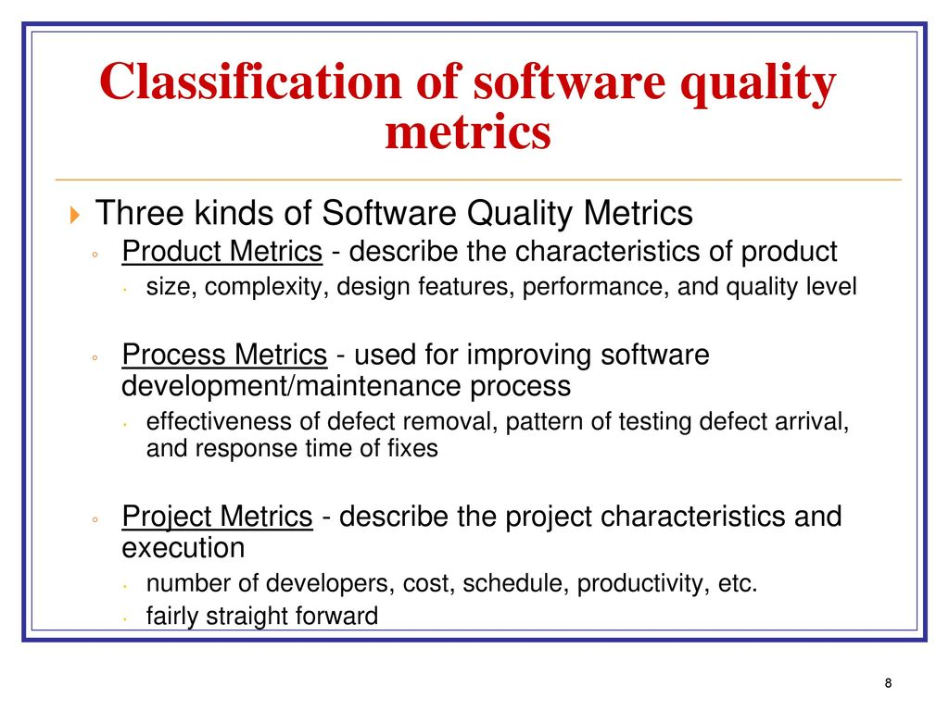

Slide 11
Software quality metrics can be further divided into three categories
Product quality metrics
In-process quality metrics
Maintenance quality metrics

Slide 12
Product Quality Metrics
Mean Time to Failure
Defect Density
Customer Problems
Customer Satisfaction

Slide 13
In-process Quality Metrics
Defect density during machine testing
Defect arrival pattern during machine testing
Phase-based defect removal pattern
Defect removal effectiveness

Slide 14
Maintenance Quality Metrics
Fix backlog and backlog management index
Fix response time and fix responsiveness
Percent delinquent fixes
Fix quality

Slide 15
The Enduring LOC Measure
LOC: Number of Lines Of Code
The simplest and most widely used measure of program size. Easy to compute and automate
Used (as normalising measure) for
productivity assessment (LOC/effort)
effort/cost estimation (Effort = f(LOC))
quality assessment/estimation (defects/LOC))
Alternative (similar) measures
KLOC: Thousands of Lines Of Code
KDSI: Thousands of Delivered Source Instructions
NCLOC: Non-Comment Lines of Code
Number of Characters or Number of Bytes
Notes:
We have to have measures of program size for various reasons. The most important is for normalisation. For example, suppose we want to consider the relative quality of programs and have available data on known faults. Knowing that Program X has 20 faults and Program Y has 40 faults tells us very little, since one program may be much larger and more complex than the other. Ideally we would like to have a measure of size of programs S which incorporates the attributes length, functionality, and complexity. A quality measure could then be defined as number of faults divided by S. In the absence of such size measures it is very tempting to go for LOC.
Consequently a common software quality measure, first used extensively in the 1970’s, is faults divided by LOC. The problems all stem from the fact that LOC does not measure functionality or complexity. A problem which is implemented in an assembly language program in 1000 LOC could be implemented in a 4th generation language program in 10LOC.
A less serious, but still important problem with LOC is that of making the measurement unambiguous. To do this we need to consider whether or not we count:
blank lines comment lines data declarations and headings non-executable compiler directives multiple executable statements on same physical line

Slide 16
Problems with LOC type measures
No standard definition
Measures length of programs rather than size
Wrongly used as a surrogate for:
effort
complexity
functionality
Fails to take account of redundancy and reuse
Cannot be used comparatively for different types of programming languages
Only available at the end of the development life-cycle

Slide 17
Fundamental software size attributes
length the physical size of the product
functionality measures the functions supplied by the product to the user
complexity
Problem complexity measures the complexity of the underlying problem.
Algorithmic complexity reflects the complexity/efficiency of the algorithm implemented to solve the problem
Structural complexity measures the structure of the software used to implement the algorithm (incudes control flow structure, hierarchical structure and modular structure)
Cognitive complexity measures the effort required to understand the software.

Slide 18
The 1970’s: Measures of Source Code
Characterized by
Halstead’s ‘Software Science’ metrics
McCabe’s ‘Cyclomatic Complexity’ metric
Influenced by:
Growing acceptance of structured programming
Notions of cognitive complexity
Notes:
Although it is known that papers concerning software measurement had appeared as early as 1955, the discipline of software metrics as we know it today is probably traceable to the work of Halstead and McCabe.

Slide 19
McCabe’s Cyclomatic Complexity Metric v
If G is the control flowgraph of program P
and G has e edges (arcs) and n nodes
v(P) = e-n+2
v(P) is the number of linearly
independent paths in G
here e = 16 n =13 v(P) = 5
More simply, if d is the number of
decision nodes in G then
v(P) = d+1
McCabe proposed: v(P)<10 for each module P
Notes:
McCabe proposed a white box testing strategy based on the set of linearly independent paths through a program. McCabe felt that the number of such paths was a key indicator not just of testability but also of complexity. Hence he defined cyclomatic complexity as this number.
On the basis of empirical research McCabe claimed that modules with high values of v were those most likely to be fault-prone and unmaintainable. Hence he proposed a threshold value of 10.
The problem with the measure is that it is a very crude measure of complexity, since in most cases it is simply the number of decision nodes plus one (a decision node is one with more than one arc going out). Equating complexity with decision nodes is over-simplistic. Indeed there have been many studies that have shown that LOC is just as good a predictor of fault-prone and unmaintainable modules as v.
Nevertheless, cyclomatic complexity has been used extensively to characterise code complexity, and it is built into most metrics (and some CASE) tools. The original reference:
McCabe TJ, ‘A Complexity Measure’, IEEE Trans Soft Eng SE-2(4), 1976, 308-320
is the most commonly cited reference in the whole of software engineering. A comprehensive description (including a full explanation of the notion of linearly independent paths which does not appear in McCabe’s paper) may be found in [Fenton and Pfleeger 1996].

Slide 20
Flowgraph based measures
Many software measures are based on a flowgraph model of a program
Most such measures can be automatically computed once the flowgraph ‘decomposition’ is known
The notion of flowgraph decomposition provides a rigorous, generalised theory of structured programming
There are tools for computing flowgraph decomposition
Notes:
Described extensively in Fenton and Pfleeger, Chapter 8.

Slide 21
Albrecht’s Function Points
Count the number of:
External inputs
External outputs
External inquiries
External files
Internal files
giving each a ‘weighting factor’
The Unadjusted Function Count (UFC) is the sum of
all these weighted scores
To get the Adjusted Function Count (FP), multiply
by a Technical Complexity Factor (TCF)
FP = UFC x TCF
Notes:
We have seen that we desperately need good ‘size’ measures for two main reasons:
1. As a normalising factor for measures of quality, productivity etc 2. As a key input for cost estimation
If function points truly measure the attribute functionality then this is a much better notion of size than LOC. Moreover, as far as cost estimation is concerned function points avoid the other key problem identified for LOC (or the similar KDSI in COCOMO): We do not have to predict FP; they are derived from the specification document.
Function point details:
External inputs are those from the user which provide distinct application-oriented data, such as file names and menu selections. Inquiries are not included (they are counted separately. External outputs are those to the user, such as reports and messages External inquiries are interactive inputs requiring a response External files are machine readable interfaces to other systems Internal files are logical master files in the system
The weighting factors for each instance of these items are:
simple average complex
External inputs 3 4 6 External outputs 4 5 7 External inquiries 3 4 6 External files 7 10 15 Internal files 5 7 10
To compute UFC just multiply relevant weighting factors for each item and sum them up. The TFC adjustment factor is given on the next page

Slide 22
Function Points: Example
Spell-Checker Spec: The checker accepts as input a document file and an optional personal dictionary file. The checker lists all words not contained in either of these files. The user can query the number of words processed and the number of spelling errors found at any stage during processing
errors found enquiry
# words processed message
Spelling Checker
words processes enquiry
User
# errors message
User
Document file
Personal dictionary
report on misspelt words
words
Dictionary
A = # external inputs = 2, B =# external outputs = 3, C = # inquiries = 2, D = # external files = 2, E = # internal files = 1
Assuming average complexity in each case
UFC = 4A + 5B + 4C +10D + 7E = 58
Notes:
which varies from 0.65 if each Fi = 0 up to 1.35 if each fi=5
Now to compute the adjusted function point count FP we have to multiply UFC by TCF. In the example, let us assume that F3,F5,F9,F11,F12,F13 are all rated 0; that F1,F2,F6,F7,F8,F14 are all rated 3; and that F4,F10 are rated 5.
Then TCF = 0.65 + 0.1 (6*0 + 6*3 + 2*5) = 0.65 + 0.1* 28 = 0.93
Thus FP = 58 * 0.93 = 54
If, for example, we know that on average an FP takes 2 person days to implement, then we can predict that it will take 108 person days to implement the Spell-Checker application.
External inputs: document file-name, personal dictionary External outputs : report on misspelt words, #words processed message, #errors message External inquiries: words processed, errors so far External files: document file, personal dictionary Internal files: dictionary
The Technical Complexity Factor (TCF) is determined by first rating the following 14 factors on a ‘scale’ 0,1,2,3,4,5 where 0 means irrelevant and 5 means essential:
F1 Reliable back-up and recovery F2 Data communications F3 Distributed functions F4 Performance F5 Heavily used configuration F6 On-line data entry F7 Operational ease F8 On-line update F9 Complex interface F10 Complex processing F11 Reusability F12 Installation ease F13 Multiple sites F14 Facilitate change

Slide 23
Function Points: Applications
Used extensively as a ‘size’ measure in preference to LOC
Examples:
FP
Person months effort
Productivity
Defects
FP
Quality
Effort prediction
E=f(FP)
Notes:
The original motivation for FP’s was for effort prediction. In its simplest form the idea is to compute, in a given organisation, the average number of person days required to implement an FP. This is done by looking at completed projects. Given enough data you plot a curve of FPs versus effort. For new projects you count the number of function points in the specification (this is not supposed to change as the project moves toward implementation), and interpolate the effort required using the curve.
FPs have become very widely used as a size measure. There is an international standards committee for FP counting. It has been claimed that in the Netherlands 60% of all major new software development contracts are based on FPs for defining commitments and effort.
The major criticism of FPs is that they are unnecessarily complex. Indeed empirical studies have suggested that the TCF adds very little in practical terms. For example, effort prediction using the unadjusted function count is no worse than when the TCF is added.

Slide 24
Function Points and Program Size
Language
Source Statements per FP
Assembler
C
Algol
COBOL
FORTRAN
Pascal
RPG
PL/1
MODULA-2
PROLOG
LISP
BASIC
4 GL Database
APL
SMALLTALK
Query languages
Spreadsheet languages
320
150
106
106
106
91
80
80
71
64
64
64
40
32
21
16
6
Notes:
This table (based on empirical research) highlights the different functionality of a source statement (or LOC) in different languages. Thus, for example, coding a program of 1 Function Point in Assembler requires approx 320 statements, which is 10 times as many statements needed for coding the same program in APL.
Evidence such as this confirms the problems of using LOC as a size measure.

Slide 25
Example: Compute the function point, productivity, documentation, cost per function for the following data
Number of user inputs = 24
Number of user outputs = 46
Number of inquiries = 8
Number of files = 4
Number of external interfaces = 2
Effort = 36.9 p-m
Technical documents = 265 pages
User documents = 122 pages
Cost = $7744/ month
Various processing complexity factors are: 4, 1, 0, 3, 3, 5, 4, 4, 3, 3, 2, 2, 4, 5.

Slide 28
Some Direct Software Measures
Length of source code (measured by LOC)
Duration of testing process (measured by elapsed time in hours)
Number of defects discovered during the testing process (measured by counting defects)
Effort of a programmer on a project (measured by person months worked)
Notes:
The LOC measure is the most commonly used. software measure The major problem with this measure is that it is used as a size measure (rather than just a measure of length). As such it has been used as a surrogate for attributes like effort, functionality, and complexity.

Slide 29
Some Indirect Software Measures
Programmer productivity
LOC produced
person months of effort
Module defect density
Defect detection
efficiency
Requirements stability
Test effectiveness ratio
System spoilage
number of defects
module size
number of defects detected
total number of defects
numb of initial requirements
total number of requirements
number of items covered
total number of items
effort spent fixing faults
total project effort
Notes:
All of these measures have been used extensively throughout the software industry. The most common, and indeed the most controversial is the measure of programmer productivity (which is effectively an industry standard).

Slide 30
Products, Processes, and Resources
Resources
Products
Processes
Process: a software related activity or event
testing, designing, coding, etc.
Product: an object which results from a process
test plans, specification and design documents, source and object code, minutes of meetings, etc.
Resource: an item which is input to a process
people, hardware, software, etc.
Notes:
Any software entity, whose properties we may be interested in measuring in, may be classified as either a product, process or resource.
The challenge is to define precisely those specific products, processes, or resources which are to be the subject of measurement. For example, if we want to measure properties of the testing process, such as its total time and the effort input to it, we have to specify precisely what is meant by the testing process: this means specifying when it starts and ends and what are its inputs and outputs. If this process is not properly defined then there will be no consistency in the measurements.

Slide 31
Internal and External Attributes
Let X be a product, process, or resource
External attributes of X are those which can only be measured with respect to how X relates to its environment
e.g. reliability or maintainability of source code (product)
Internal attributes of X are those which can be measured purely in terms of X itself
e.g. length or structuredness of source code (product)
Notes:
Although external attributes are the ones that appear to be the most important to measure, we are ultimately dependent on measures of internal attributes if we are going to measure the external ones.

Slide 32
The Framework Applied
ATTRIBUTES
ENTITIES
Internal
External
PRODUCTS
Specification
Source Code
....
Length, functionality
modularity, structuredness, reuse ....
maintainability
reliability
.....
PROCESSES
Design
Test
....
time, effort, #spec faults found
time, effort, #failures observed
....
stability
cost-effectiveness
....
RESOURCES
People
Tools
....
age, price, CMM level
price, size
....
productivity
usability, quality
....
Notes:
For any metrics activity you need to ask:
Is this measurement for assessment or prediction?
What are the entities being measured (specifically what are the precise products, processes, resources)?
Which attributes, and are they internal or external?

